Slide 1
CSC 101 Applied Physics Spring 2023
Chapter-3 Equilibrium of a Particle

Slide 2
Free-Body Diagram: Example from Book
Free-Body Diagram (FBD):-
Steps to draw a FBD:
Draw Outlined Shape;
It means, we need to draw an outline such that the particle object is ISOLATED/FREE from its surroundings (forces acting)
2) Show all the Forces;
We need to indicate all the forces acting upon the particle/object
3) Identify Each Force;
We need to LABEL each force; it means that we need to label or represent each force with Magnitude and Direction/angle

Slide 3
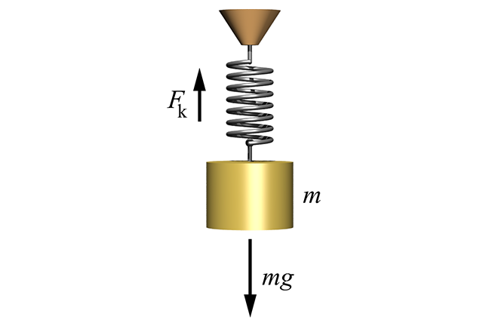
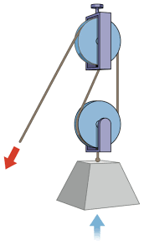
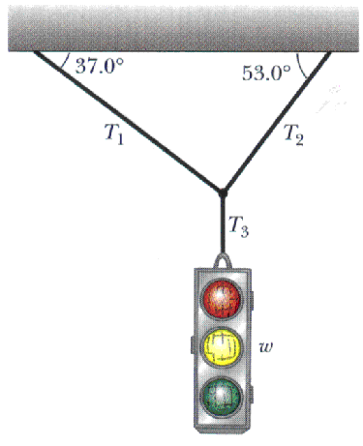
Free-Body Diagram: Example from Book
Connection types:
As we know that there are three types of Connections, to which an object can be tied/connected/hanged. These are;
Spring, 2) Pulley, 3) Cables
Spring
Pulleys
Cables

Slide 4
Free-Body Diagram: Example from Book
Tension “T” or Stress:
Force “T” is in-fact a stress/tension and this force can be observed in a SPRING, in a cable as well
In the spring, there is one characteristic that
defines the “Elasticity”
This Elasticity is known as Spring-Constant
or stiffness k
It is given by F = Ks
Where F is force exerted on spring, K is Spring constant and s is new length

Slide 5
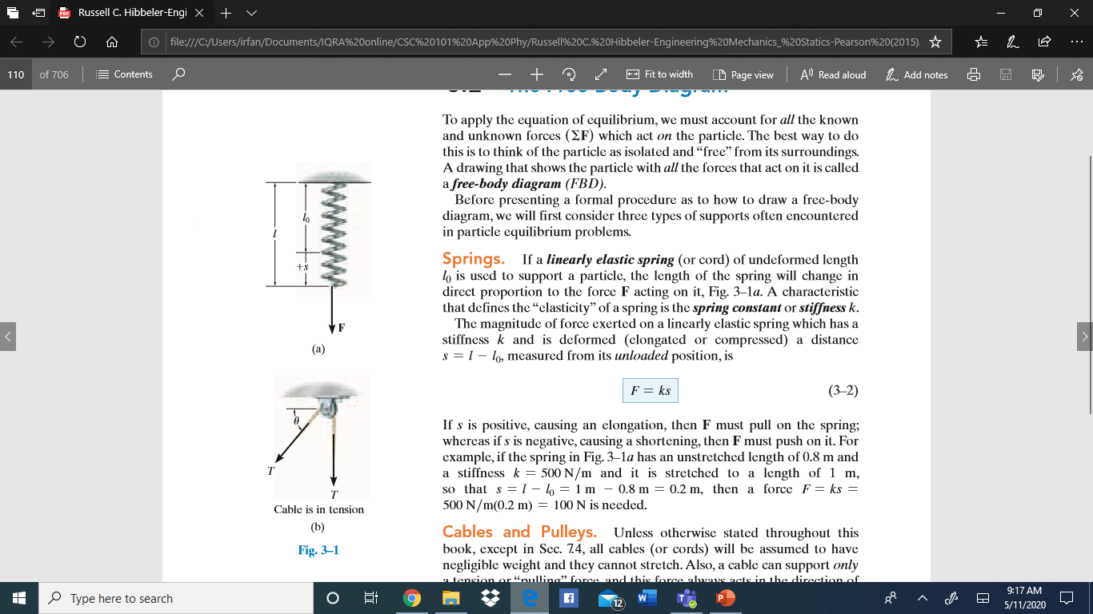
Free-Body Diagram: Example from Book
l₀ = unstretched length
s = stretched distance
The new length can be greater than original or
it can be smaller than the original length.
s = is change is length (smaller or greater)
Unloaded
position

Slide 6
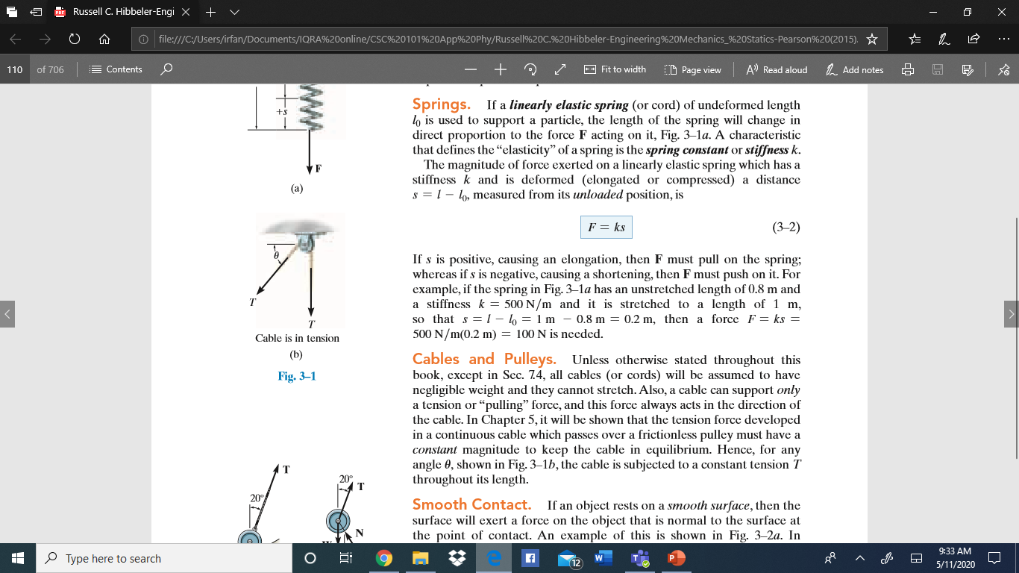

Free-Body Diagram: Example from Book
K = 500N/m
l = 1 m (stretched length)
l₀ = 0.8 m (original length)
s = is change in length, and in our case,
s = l - l₀ = 1 m – 0.8 m = 0.2 m
So, F = ks, F = 500N/m x 0.2 m = 100 N force is needed to stretch the spring

Slide 7
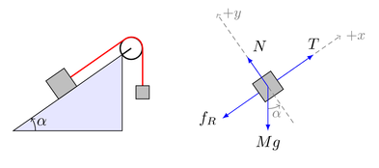
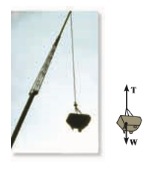
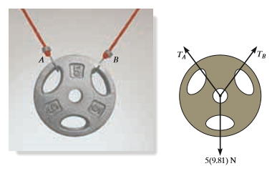
Free-Body Diagram: Example from Book
Previous examples: completed
Ex:1
Ex:2
Ex:3

Slide 8
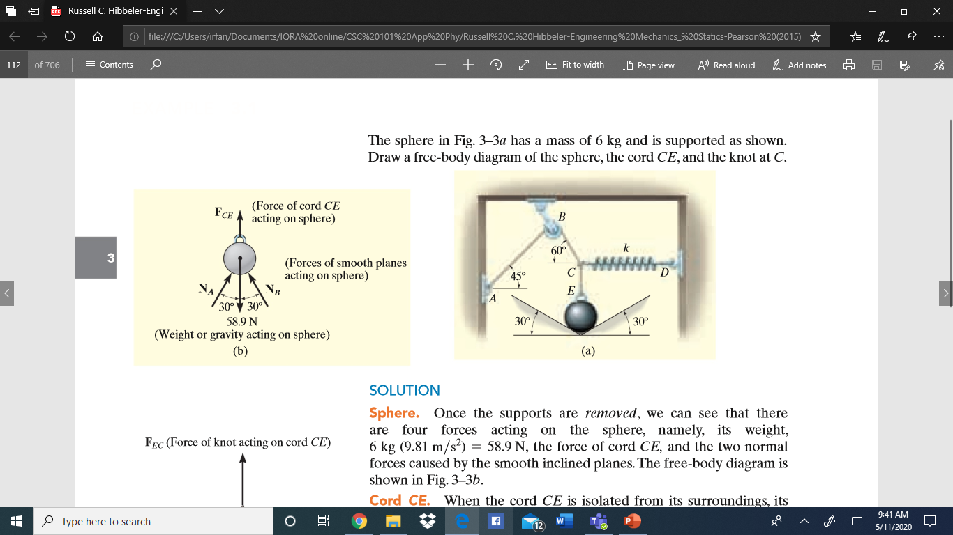
Free-Body Diagram: Example from Book
Example: Page 90 of book
A sphere is tied from a point E by a spring on the right hand side at point C. The spring is attached to the wall at point D.
This sphere is also tied over
A pulley at point B via a
cable
This cable is also attached
To a wall at point A.
There are different angles
shown in the diagram.

Slide 9
Free-Body Diagram: Example from Book
Example: Page 90 of book
Our objective is to Draw a Free-Body Diagram for THREE OBJECTS:
1) Knot at C
2) Cord CE
3) Sphere

Slide 10
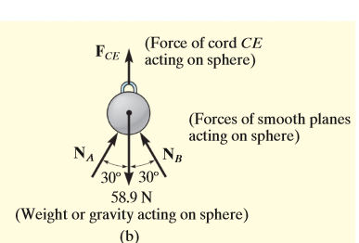
Free-Body Diagram: Example from Book
Example: Page 90 of book
Our objective is to Draw a
Free-Body Diagram of:
Sphere
Now observe only the sphere
and see two blue arrows:
There are two forces that are
acting on the sphere:
F_{CE} in the upper direction as
Indicated by arrow a)
Wight (58.9 N) in the downward direction b)
a)
b)

Slide 11
Free-Body Diagram: Example from Book
Example: Page 90 of book
Steps to obtain FBD:
Draw Outlined Shape;
It means, we need to draw an outline such that the particle object is ISOLATED/FREE from its surroundings (forces acting)
2) Show all the Forces;
We need to indicate all the forces acting upon the particle/object
3) Identify Each Force;
We need to LABEL each force; it means that we need to label or represent each force with Magnitude and Direction/angle

Slide 12
Free-Body Diagram: Example from Book
Example: Page 90 of book
The sphere is
isolated/free from the surroundings,
Two forces acting on sphere are shown F_{CE} and weight w
Forces are labelled, it means show the values of F_{CE} and weight w (58.9N)
a)
b)
Free-Body Diagram of sphere

Slide 13
Free-Body Diagram: Example from Book
Example: Page 90 of book
Now we will see the free body diagram for Cord CE
2) Cord CE

Slide 14
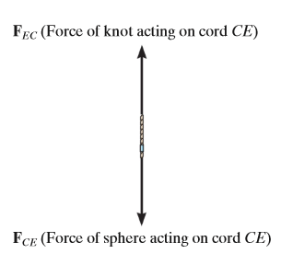
Free-Body Diagram: Example from Book
Example: Page 90 of book
The cord is
Isolated/free from the surroundings,
Two forces acting on cord are shown F_{CE} and F_{EC}
Forces are labelled, since values are not given
Free-Body Diagram of cord CE

Slide 15
Free-Body Diagram: Example from Book
Example: Page 90 of book
Now we will see the free body diagram for Knot at C
3) Knot at C

Slide 16
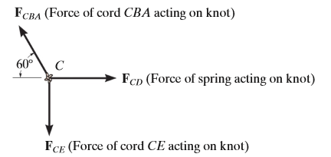
Free-Body Diagram: Example from Book
Example: Page 90 of book
The knot is
isolated/free from the surroundings,
Three forces acting on knot at C are: F_{CBA} a F_{CD} and F_{CE}
Forces are labelled, since no values (magnitude and direction) are given

Slide 17
Free-Body Diagram: Example from Book
FBD: Sphere
FBD: Sphere
FBD: Sphere

Slide 18
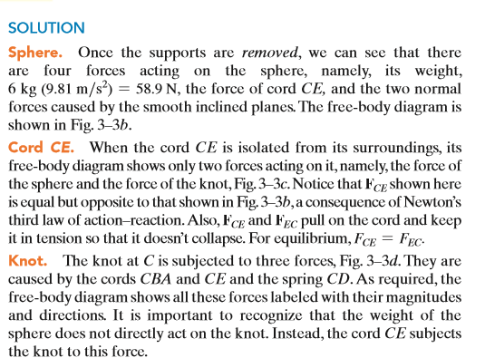
Example: Page 90 of book

Slide 19
Free-Body Diagram: Example from Book
Example: Page 90 of book
Process to obtain FBD for this is given on next slide:

Slide 20
Free-Body Diagram: Solution diagram
FBD: Sphere
FBD: Sphere
FBD: Sphere

Slide 21
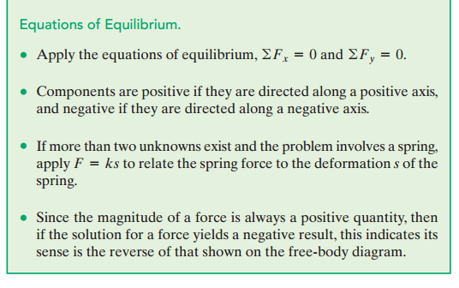
Equations for the Equilibrium:

Slide 22
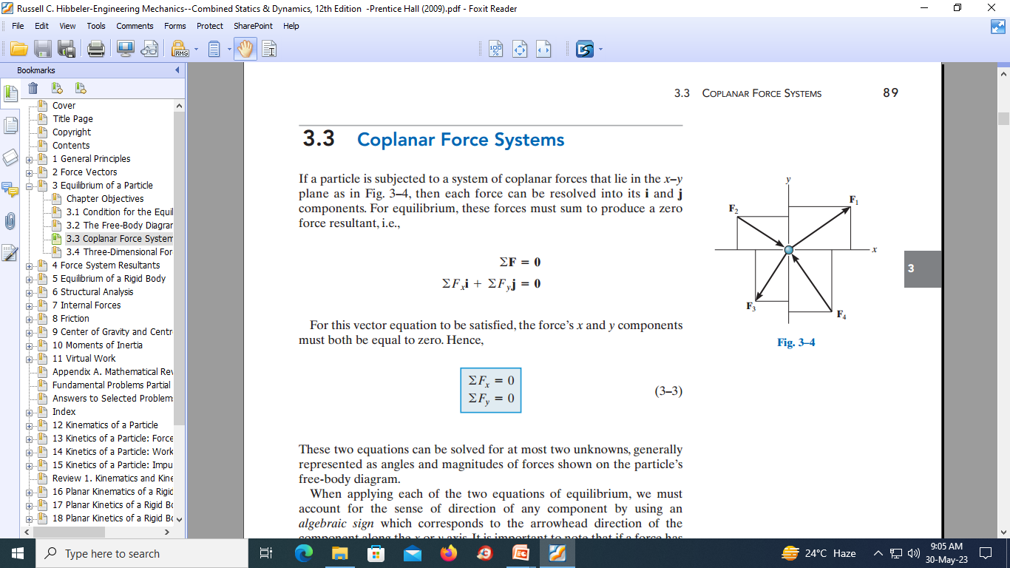

Slide 23
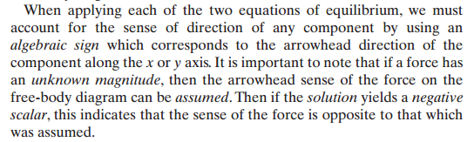

Slide 24



Slide 25
